Slide 1
Datazen round 2
By:Sparsh gupta

Slide 2
Datascience
In this datascience project , the data given was based on invoices of some orders placed by various countries.
I have cleaned the dataset and made a new column to ease my further inferences.
Next I made some inferences using the dates that I extracted from the ‘InvoiceDate’ column.
I have used the K-Means clustering method because the given dataset did not have any dependant variable .
After performing the elbow method , I took K=4 as the value to perform clustering.

Slide 3
Some further inferences that I can think of but could not deliver are : using the stockcodes to find out some correlation between the countries and the products they prefer to buy,using the time on which the orders have been placed to extract some useful data.

Slide 4
Backend
I have made a registration form that takes basic entries from the student and send those to my mongodb database .
The css and overall look of the website can be improved nut it has all the functionalities covered
Once you submit the form it gives a confirmation too.

Slide 5
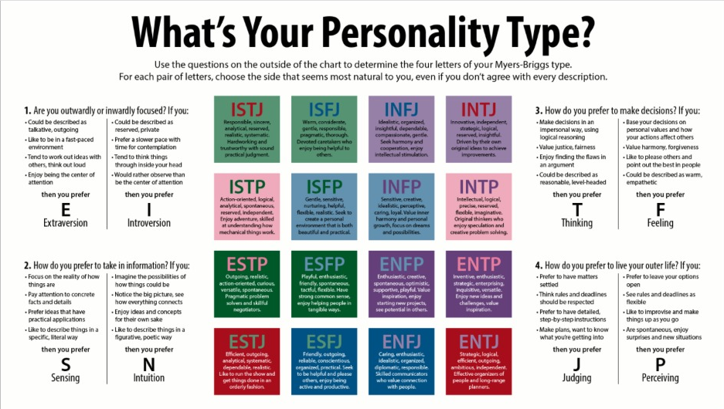
backend
I have made a personality test on Mayer briggs test given below:

Slide 6
The questions are framed based on the test and one can answer in the yes/no format.
And after submitting you are redirected to another page that shows your personality traits.
Future inferences : use MlL to further identify pattern and draw inferences from the data to give even better and customized results.

